Slide 1
Creating Useful Metrics to Provide Quality Software

Slide 2
Introduction
Helene Astier
Quality Assurance Manager

Slide 3
About the Presenter
Background
From Nice, France
Moved to the U.S. in 1999, age 19
Education
Florida Institute of Technology
Bachelor of Science in Computer Science in 2001 – Highest Honors
Master of Science in Computer Science in 2002 – Software Development option
MBA in 2003 - Computer Science option
Academically trained and worked in university QA research lab.
Two best-selling authors in software testing: Dr. Cem Kaner and Dr. James Whittaker
Internet Explorer (Microsoft) and TI Interactive! (Texas Instruments)
Experience
Masco – Fortune 200
Created metrics to represent Quality Assurance at the project management office (PMO)
Vice President, Quality Assurance and Process Control Manager at Incapital Holdings, LLC – Fixed income security trading
Created a Quality Assurance team from scratch
Created all the processes for the application development department and corresponding metrics
Quality Assurance Manager at Cars.com
Manage a cross functional distributed team of 40 QA specialists
In the process of building department and team metrics

Slide 4
Company Overview
Founded in 1997
Headquartered in Chicago
Over 1,300 employees nationwide
Owned by Gannett Co., Inc.
Notes:
Cars.com was founded in 1997 and the site went live in 1998.
We’re headquartered in Chicago and our workforce has doubled over the past five years to more than 1,300 employees nationwide
On Oct. 1 of this year, the company was bought by Gannett.

Slide 5
Company Overview
We offer credible and easy-to-understand information from consumers and experts to help buyers formulate opinions on what to buy, where to buy and how much to pay for a car.
Cars.com sees approximately 30 million visits each month.
We serve as the automotive industry’s digital marketing expert, providing data-driven insights and products to inform marketing strategies and help dealers and manufacturers more effectively reach in-market car shoppers.
Notes:
Cars.com is an award-winning independent research site for car shoppers, where they can get access to credible information from other consumers as well as experts to help make the car shopping process as easy as possible.
We see about 30 million visits each month to our site and leverage our growing audience of in-market car shoppers to inform the digital marketing strategies of our dealer and manufacturer customers, who advertise on our site.

Slide 6
Audiences
Customers: Delivering revenue for the company
Dealers
OEMs
National Advertisers
Consumers: Delivering traffic & value to advertisers
Notes:
Cars.com is first and foremost a consumer-centric site – we focus on building an online destination that meets the changing needs of today’s car shoppers.
Due to the strength of our audience, we’re able to deliver consumer insights and innovative digital marketing products that serve the needs of our advertiser customers.

Slide 7
Introduction / Definitions

Slide 8
Agenda
Introduction / Definitions
QA Department Metrics
People
Process
Technology
Metrics to Measure Change in People, Process and Technology
Metrics consumed by the QA Group to enhance the department
Metrics Created by QA Group as Feedback to Other Teams

Slide 9
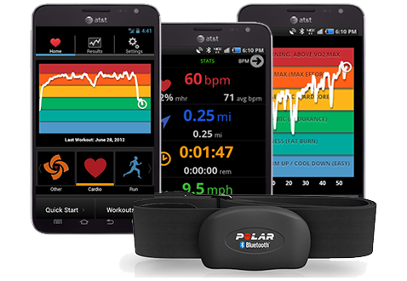
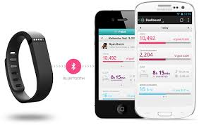
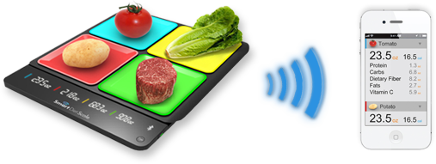
Metrics – Everywhere!

Slide 10
Metrics - Definition
Metrics (noun): Standards of measurement by which efficiency, performance, progress, or quality of a plan, process, or product can be assessed.
Source: BusinessDictionary.com
Notes:
http://www.businessdictionary.com/definition/metrics.html#ixzz3GZBwjhgr

Slide 11
Trends - Definition
Trend (noun): A pattern of gradual change in a condition, output, or process, or an average or general tendency of a series of data points to move in a certain direction over time, represented by a line or curve on a graph.
Source: BusinessDictionary.com
Notes:
Read more: http://www.businessdictionary.com/definition/trend.html#ixzz3GZGttxko

Slide 12
Benchmark - Definition
Benchmark (noun): Standard, or a set of standards, used as a point of reference for evaluating performance or level of quality.
Benchmarks may be drawn from a firm's own experience, from the experience of other firms in the industry, or from legal requirements such as environmental regulations.
Source: BusinessDictionary.com

Slide 13
Metrics/Trends/Benchmarks - Purpose
Target metrics
Predict
Monitor
Improve
Explain
Promote Transparency
Raise Awareness
Notes:
Predict: Track the past to predict the future.
Monitor: Monitor after a change.
Improve: Retrospectives & Continuous improvement.
Explain: Tell a story about people, processes or technology.
Promote Transparency: Show the department (in)efficiency.
Raise Awareness: Showcase the work of a particular team, person, process improvement or technology improvement.
→ Companies need to target their metrics.

Slide 14
Stakeholders
QA Department
Other Departments
Upper Management
Boards, Shareholders, Audits
Product Teams
Notes:
QA Department
Product Teams
Other departments – Developers / Product / Support (…)
Upper Management
Boards, Shareholders, Audits

Slide 15
Soft Metrics vs. Hard Metrics
vs.
Notes:
Soft Metrics: Ask your staff – Sharepoint, Survey Monkey, Replicon
Hard Metrics: Created by a tool – JIRA, VersionOne, HPQC.

Slide 16
Complexity of Metrics
1 Dimension Metrics
2 Dimensions Metrics
3 Dimensions Metrics
4 Dimensions Metrics
Notes:
1 Dimensional metrics – # of bugs in the backlog.
2 Dimensional metrics – Often measured against time or people (ex. Coefficient) - # of bugs found per team or during a month.
3 Dimensional metrics – Often measured against time and people - # of bugs found per team during a month.
4 Dimensional metrics – Many measures of time (trend)

Slide 17
Types of Metrics
Measure 1 | Measure 2 | Quantifier | Time | Teams
Stories | Stories | Number | Day | Product/Portfolios Teams
Bugs | Bugs | Size | Month | QA/Dev/Support Teams
Post prod Issues | Post prod Issues | Severity/Priority | Quarter | Individuals
Test Cases | Test Cases |  | Year
Automation | Automation |  | Sprint
Unit Tests | Unit Tests |  | Hours worked

Slide 18
How to Get Efficient Metrics
Companies must have clear processes and goals to be able to build efficient metrics.

Slide 19
Metrics – Company Maturity
Metrics often illustrate the maturity
of a company.
Way they are collected
The stories they tell
What is measured
Notes:
Metrics often illustrate the maturity of a company.
Way they are collected
What is measured
The stories they tell

Slide 20
QA Department Metrics People. Process. Technology.

Slide 21
People
Metrics to plan, monitor teams or individuals and measure their productivity.

Slide 22
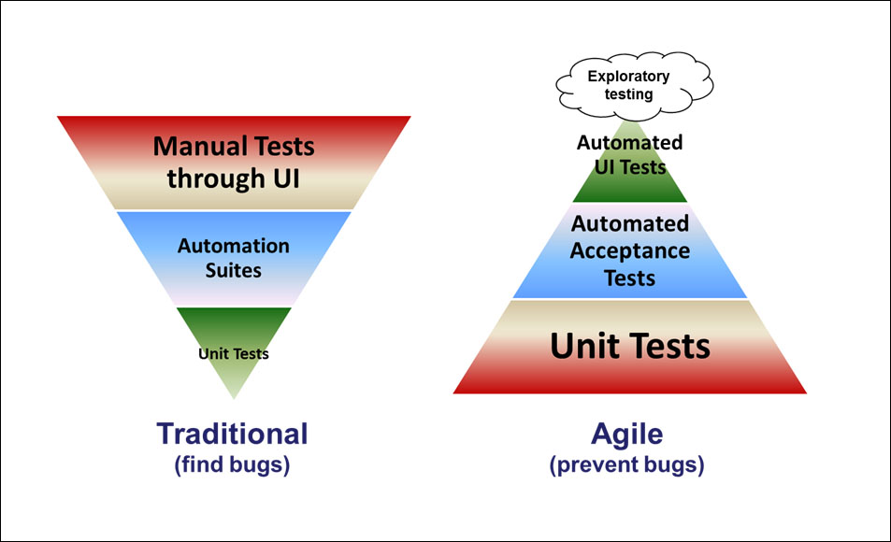
Team Composition - The Agile Pyramid
Source: The Agile Pyramid, AgileCoachJournal.com
Notes:
(http://www.agilecoachjournal.com/index.php/2014-01-28/testing-2/the-agile-testing-pyramid/)

Slide 23
Planning Teams
Attrition rate of teams (U.S. vs. Offshore)
Number of departures / time
Offshore teams usually have a high attrition rate.
Ratio Dev/QA – Not accurate
Industry ratio ¼
Depends on the industry

Slide 24
Planning Teams
Metrics to monitor teams or individuals
How many hours resources work per week on average.
40 hours a week + 3 weeks vacation.
No one put 320 hours per week of actual work.
Create a coefficient to plan actual work.
Not everyone/every team has the same velocity.

Slide 25
Manual
Creating new test cases
Maintaining test cases
Feature testing, running regression, exploratory testing
Other tasks
Percentage
of time spent
Notes:
Percentage of time spent on creating new tests cases during a certain period
Percentage of time spent on maintaining test cases during a certain period
Percentage of time feature testing, running regression, exploratory testing (…)
Percentage of time spent on doing other tasks during a certain period (ex. Meetings)

Slide 26
Automation
Automating new tests
Maintaining test cases
Running test cases
Other tasks
Percentage
of time spent
Notes:
Percentage of time spent on automating new tests during a certain period
Percentage of time spent on maintaining test cases during a certain period
Percentage of time running the test cases
Percentage of time spent on doing other tasks during a certain period (ex. Meetings …)

Slide 27
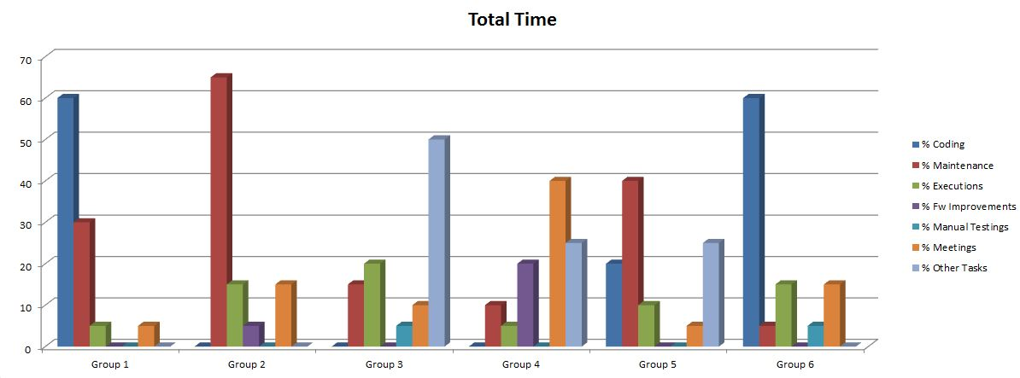
People - Automation
Time spent on running scripts, creating new scripts, in meetings.

Slide 28
Process
Metrics to measure health of products, day to day operations and enforcement of processes, retrospectives and continuous improvement.

Slide 29
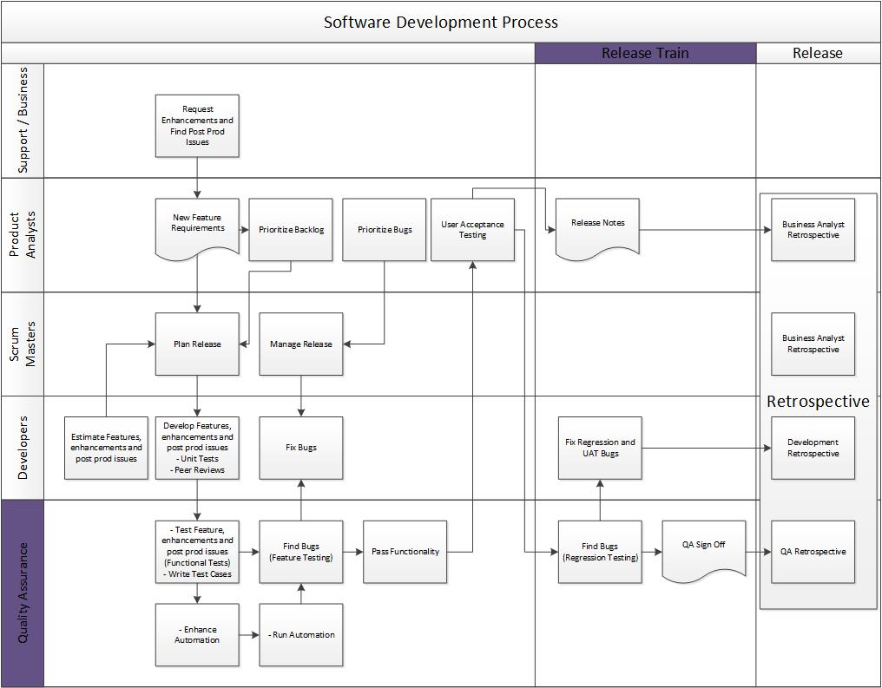
The QA Process

Slide 30
QA Process
Manual
Test features
Write test cases
Find bugs
Automation
Enhance automation
Run automation
Find bugs
Regression
Run automation
Run manual suite
Find bugs

Slide 31
Manual Feature Testing
Stories verified
Test cases written
Bugs found during feature testing
Number of…
by team/person over period of time.
Notes:
Number of stories verified (Features Tested) by team/person over a period of time
Number of test cases written by team/person over a period of time
Number of bugs found during feature testing by team/person over a period of time

Slide 32
Automation Feature Testing
Test cases automated
Test cases passes vs. fail
Bugs found during feature testing
Number of…
by team/person over period of time.
Notes:
Number of new test cases automated by team/person over a period of time
Number of test cases passes vs. Fail
Number of bugs found during Feature Testing by automation team/person over a period of time

Slide 33
Manual and Automation - Regression
Test cases passes vs. fail
Bugs found during regression testing
Number of…
by team/person over period of time.
Notes:
Number of test cases passes vs. Fail
Number of bugs found during Regression testing by automation team/person over a period of time

Slide 34
Manual Testing Coverage
Manual Testing Coverage
Automation Coverage
Notes:
What is manual testing coverage?
Coverage of manual test cases / stories (Reqs)
Coverage of manual test cases / features
Coverage of manual test cases / software
& Tractability Matrices and Gap Analysis
What is automation coverage?
Coverage of automation / manual test cases
Coverage of automation / features
Coverage of automation / dev code

Slide 35
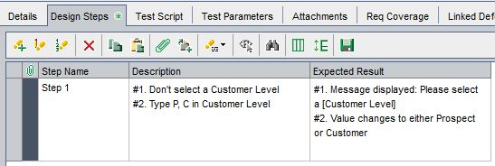
Manual and Automated testing
Manual | Automated

Slide 36
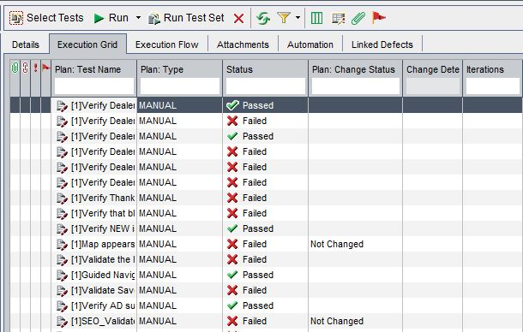
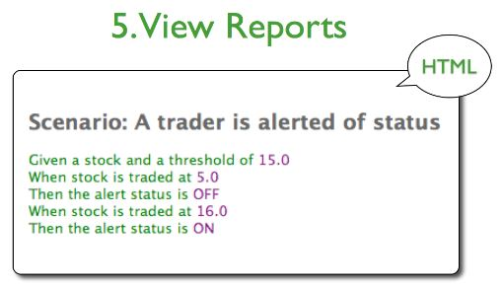
Manual and Automated testing
Manual | Automated

Slide 37
Automation
QA Automation Metrics
Total amount of automated test cases
Number of test cases ready to be automated
Number of defects caught with executions of automation
How many sprints behind are we?
Notes:
QA Automation Metrics
Total amount of automated test cases
Number of test cases ready to be automated
Number of defects caught with executions of automation during a certain period
How many sprints behind are we?

Slide 38
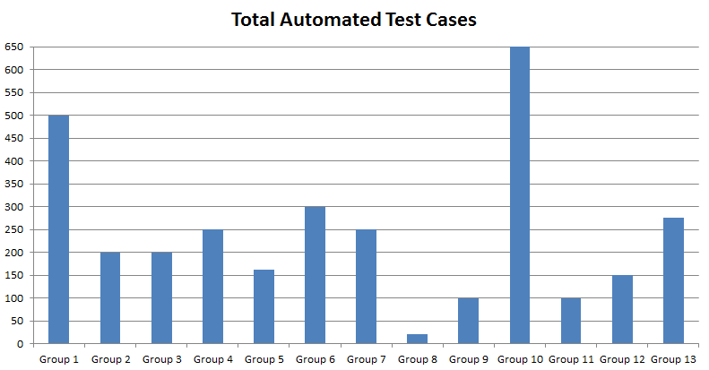
Total Amount of automated test cases

Slide 39
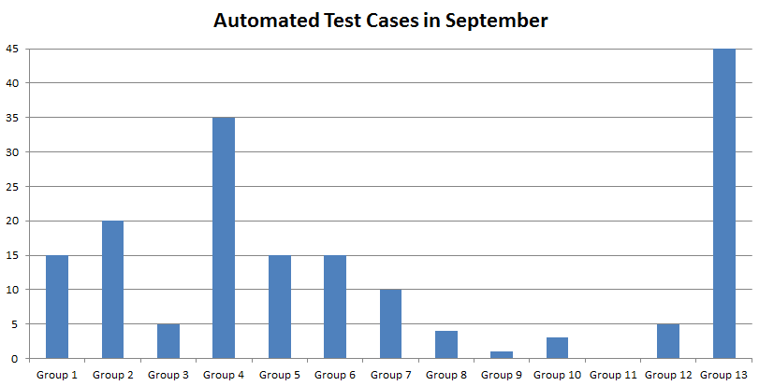
Number of test cases automated during a certain period

Slide 40
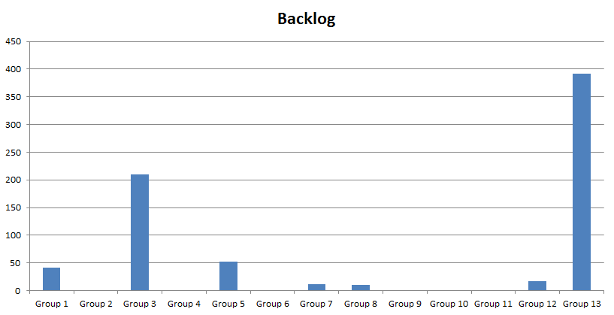
Number of test cases ready to be automated

Slide 41
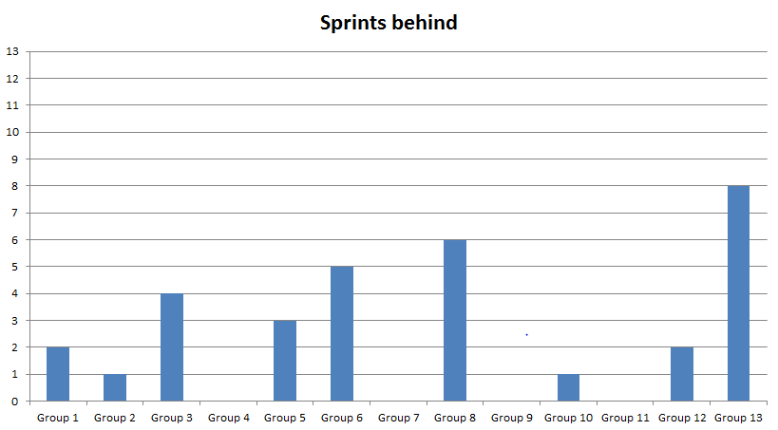
Sprint Behind

Slide 42
Technology
Metrics to see if the introduction of a technology improved productivity and QA Automation Metrics.

Slide 43
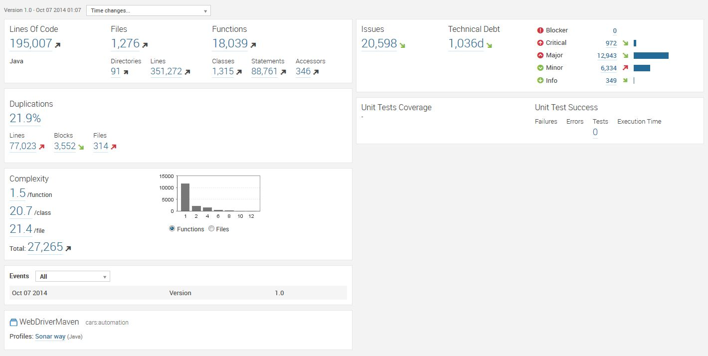
Sonar – Automation Health

Slide 44
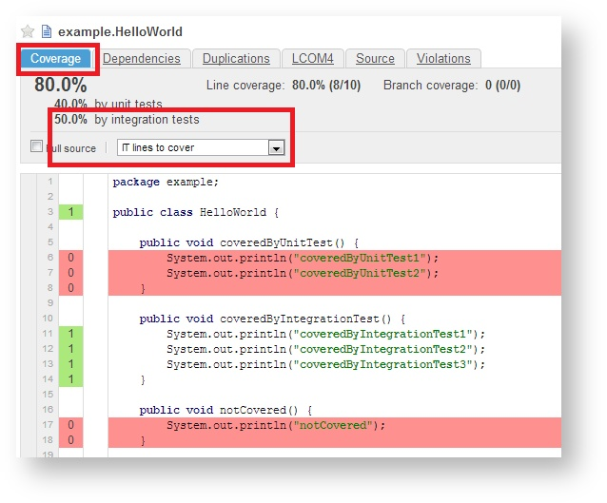
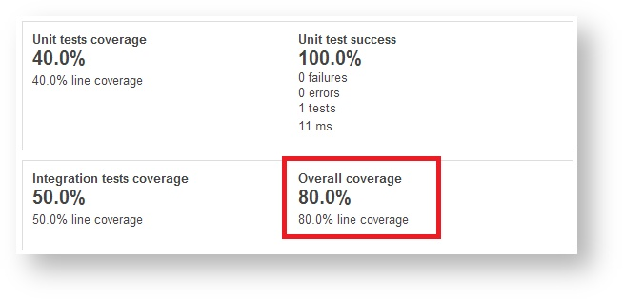

Slide 45
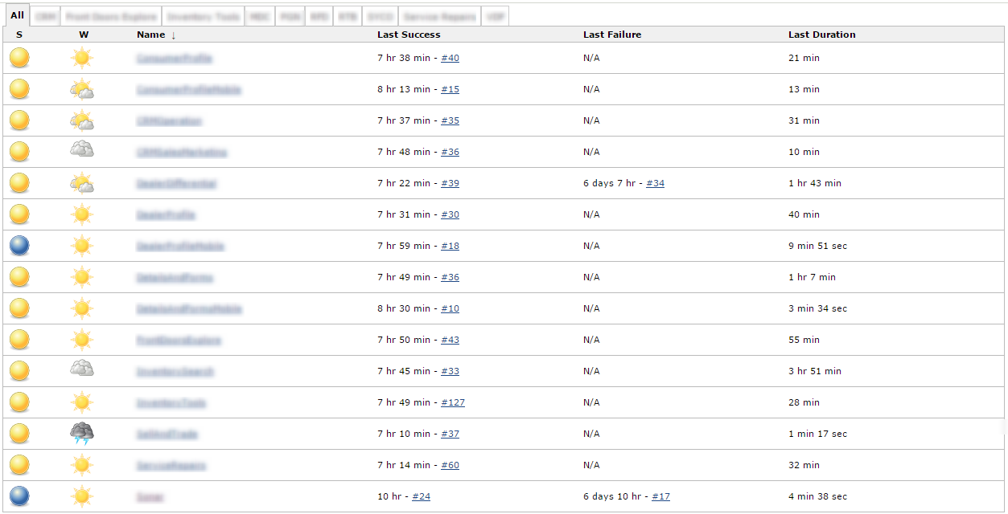
Automation Jenkins

Slide 46
Automation Metrics
Pass Fail Ratio: % of test passed vs. test failed

Slide 47
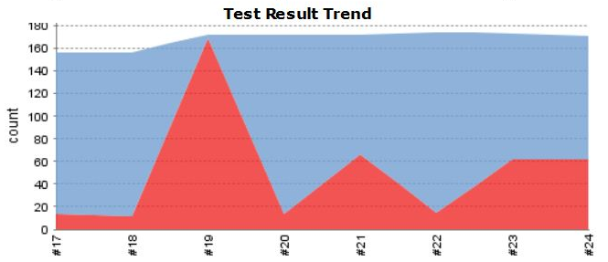
Automation - Test Result Trends

Slide 48
Metrics to Measure Change in People, Process and Technology

Slide 49
Change in People
Metrics to measure if a change in person improved productivity:
New QA Person
Change in compensation
Change in seating
Notes:
Metrics to measure if a change in person improved productivity
Every time a QA person is changed in a group, the velocity of testing might change
Change in the seating
Change in the compensation structure (…)

Slide 50
Change in Process
Metrics to measure if a change in process improved productivity:
Reduce the Number of hours worked
Reduce the Number of post prod issues introduced
Increase the Number of bugs found
Notes:
Metrics to measure if a change in process improved productivity
Calculate the productivity (number of hours worked, number of bug found, number of defects introduced …) prior and after rolling out a new process

Slide 51
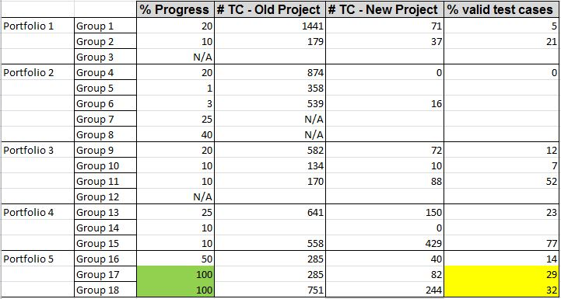
Process
Metrics to monitor progress on a
process change:

Slide 52
Change in Technology
Metrics to measure if the introduction of a technology improved productivity:
Reduce the Number of hours worked
Reduce the Number of defects introduced
Increase the Number of bugs found
Notes:
Metrics to see if the introduction of a technology improved productivity
Calculate the productivity (number of hours worked, number of bug found, number of defects introduced …) prior and after rolling out a new technology

Slide 53
Metrics consumed by the QA Group to Enhance the Department

Slide 54
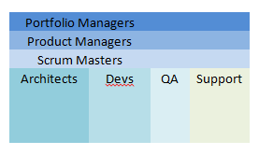
People - All
Control Groups

Slide 55
The QA Process

Slide 56
Down Stream Metrics Consumed by QA Team
Down Stream = QA Control Group is Support/Business
Post-production issues incurred
Number/percentage per team/person – support tickets – over period of time.
What my team needs to be testing
Omniture, Splunk, Google Analytics
Created to end test cases based on real customer metrics
Choose the mobile devices, browsers we test based on real customer metrics
Notes:
Down Stream = QA control group is Support/Business
Number/Percentage of post production bugs incurred per team/person – support tickets - over a period of time
Omniture, Splunk, Google Analytics – shows what my team needs to be testing
Created our end to end test cases based on real customer metrics
Choose the mobile devices and browsers we test on based on real customer metrics

Slide 57
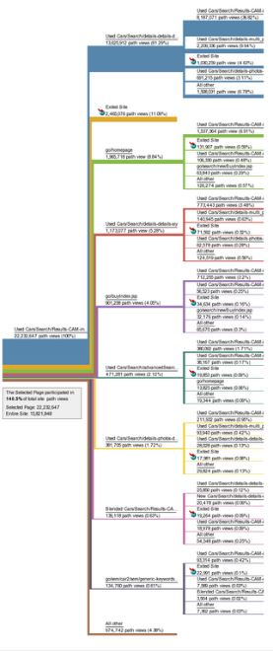
Omniture

Slide 58
Omniture

Slide 59
Down Stream Metrics consumed by the QA team
Up Stream = QA is the Control Group for Product Owners / Business Analysts
Hours required
To develop/test stories and post production issues that go into each sprint, compare them to Dev and QA hours available
Percentage of emergencies
Priority/urgency of stories that go into production
Notes:
Hours required to develop/test stories and post prod issues that go into each sprint and compare them to Dev and QA hours available.
Priority / urgency of stories that go into production – percentage of emergencies.

Slide 60
Up Stream Metrics monitored by the QA team
Up Stream = QA is a Control Group
for the Scrum Masters
Burn Down
Velocity
Understand of the dev team
Understand what’s coming
Coming Down the Line
Monitor chart (story hours, vs. dev hours)
Notes:
Monitor the Burn Down chart (story hours vs. dev hours …)
Understand Velocity of the dev team
Need to understand what is coming down the line.

Slide 61
Up Stream Metrics monitored by the QA team
Up Stream = QA Control Group
is Development
Unit Tests
Coverage
Number/percentage of stories, bugs that have been peer reviewed
Peer Reviewed
Number/percentage of stories, bugs that have unit tests
Unit test coverage
Notes:
Number/Percentage of stories, bugs that have unit tests.
Unit Test coverage
Number/Percentage of stories, bugs that have been peer reviewed.

Slide 62
Metrics Created by QA Group as Feedback to Other Teams

Slide 63
Retrospectives
Growing/Reducing Backlog
Velocity
Feedback
Notes:
Growing / Reducing backlog (Feedback - Product Owners / Business Analysts and Support)
How many stories and bugs were closed vs. Opened this release
How many post production bugs were willingly introduced into the software
Priority/Severity → Should see severe bugs go down, low bugs grow incrementally
Velocity (Feedback - scrum masters)
How long did it take to develop those stories and bugs (planned vs. Actual)
How long did it take to test those stories and bugs (planned vs. actual)
Feedback - Devs
What percentage of tickets were reopened or how many bugs were associated to each story / functionality
What were the reasons the tickets were reopened

Slide 64
Company Metrics - Management
Number of stories completed
Number of bugs opened vs. closed
Number of bugs willingly introduced
Backlog growth/attrition
Notes:
Number of stories completed this month & previous months by product teams / portfolios and urgency
Number of bugs opened vs. closed this month & previous months by product teams / portfolios and severity
Number of bugs willingly introduced into the software this month & previous months by product teams / portfolios and severity
Backlog growth / attrition this month & previous months by product teams / portfolios and severity

Slide 65
Chargebacks
$ Time to Develop (Dev + QA)
Amortized software cost
Prioritization
Notes:
Companies sometimes decide to charge back development and QA time to product teams to force them to prioritize / think about costs incurred and pick revenue generating features
(dev per hour cost + QA per hour cost) * Time to develop a feature + amortized software cost.

Slide 66
Conclusion

Slide 67
Conclusion
Need clearly defined SDLC
Need tool that allows reporting
Metrics are subject to interpretation
Notes:
Quality metrics can only be achieved with a clearly defined Software Development Lifecycle (SDLC) process that is used consistently by all development teams.
The process needs to be combined with a tool that will allow the workers to report on their progress along the SDLC cycle and collect metrics along the way.
Metrics are always subject to interpretation, therefore interpreting metrics correctly and understanding why they show a certain result is as important as creating the metrics itself.

Slide 68
Questions?

Slide 69
Thank you for the opportunity! Helene Astier Quality Assurance Manager hastier@cars.com
312 898 2550

Slide 70
Bad Metric vs. Good Metric

Slide 71
Guess what the metric means!

